Slide 1
Notes for Organizers and Trainers
READ THIS!
This session is designed for use on Microsoft teams with 3 breakout rooms and 6 hrs duration
Teaching notes and background information are in the Notes section below each slide
It is not intended that all the background information in the Notes sections should be presented, it is there to provide context for presenters and to help deal with questions.
Notes:
History of this course
Spring 2021. Course initiated by Clare van Hamel, Foundation School Director, Severn Deanery to provide a Deanery based Ethics course in line with the Foundation Programme curriculum.
First run 4 May 2021 – went well, modified as below:
Slide 5
Do we want to delete confidentiality as an example? - ✔
Reminder to do sli.do – maybe add text reminder onto the intro slide - ✔
Move objectives slide to here? Or leave it after reminder of what the curriculum is – probably flows better to leave the Objectives after the curriculum but moved the ‘Principles of Education’ small group slide to after ‘Objectives’ and just before the ‘Programme for the Day’
Slide 11
Explicitly encourage to present the disagreements, rather than just what they agreed - ✔
Slide 12
Could we sort of construct this like a mind map/diagram that we populate one by one? Just to break up the speech somewhat –
Or alternate between one of their presented and one of ours - added to the advice for trainers on how to run this.
Slide 14
Should we put a note about stoicism underneath virtue? Added to ‘Discuss’ in the Notes rather than making the slide busier
Slide 16
Revisit the Venn diagram before going into virtue ethics, to remind them of the structure that we have covered the pre-theory, and now into the three main approaches. Venn diagram overview slide repeated before each new change of ethical system.
Slide 18
Again, visit the Venn diagram? Venn diagram overview slide repeated before each new change of ethical system.
Slide 29
Brief summary/reminder of the systems before they go into the activity Venn diagram overview slide repeated before each new change of ethical system.
Slides on ethical theories
Have been reorganised to present the theories more quickly and then present the problems associated with each theory after the Activity.
From participant feedback
Could send the breakout rooms to participants beforehand and allocate them before so that it’s more straightforward on the day? Discussed after the day – problem is if we have no-shows or people already sharing accommodation.
More time on cases – this needs a bit of a re-think and some discussion. Probably better to treat the cases as small group discussions rather than simply delivering them.
Agreed that we need to have some kind of acronym/quick aide-memoire and then give them the chance to apply this to some cases.
A challenge for participants over coffee or lunch.
Would be good to change the cases to be more medical, e.g. confidentiality, HIV, ?sedation ?self-discharge As above

Slide 2




Ethics
for Foundation doctors
To include the Medical Defence Union, Four Roman Emperors and Several Philosophers
Notes:
Trainers
Introduce yourself and welcome participants
As part of the introduction, explain how this course has evolved and developed. It was initiated by Clare van Hamel, Foundation School Director, Severn Deanery to provide a Deanery based ‘Ethics’ course in line with the Foundation Programme curriculum which commences in August 2021 After the day participants who leave their online evaluation can obtain a pdf of the course slides
Sli.do on:
How would you rate your knowledge of Medical Ethics?
How confident do you feel in your ability to apply an ethical approach to everyday work issues?
Pre-course administration and organisation:
Resources needed:
Login to Teams account
List of links for breakout group activities
Dealing with problems
So far we have not been able to make breakout rooms work well on Teams. Parallel sessions mostly work but may need an organiser to enter the rooms before participants can.
After the day
Participants can evaluate the course on Maxcourse and then obtain a pdf of the slides
Background information for Trainers
Contributors
Jon Barnes
Clare van Hamel
Tor van Hamel Parsons
Laura Machin, Senior Lecturer in Medical Ethics, Lancaster Medical School
Mike O’Connor

Slide 3
Ground rules
Time – please be prompt returning from breaks
Mute yourself
Videos on where possible
Confidentiality
Respect
Please put questions in the chat as we go
Notes:
Inform the participants
Time – will run tightly to time so please be prompt in returning from breaks
Mute yourself to reduce noise
Videos on to be as interactive as possible – it’s nicer for teachers to know you’re engaging
Confidentiality as real issues may come up – this session is not recorded
Respect – again real issues may come up
Questions as anyone thinks of them, don’t wait
Background Information for trainers

Slide 4
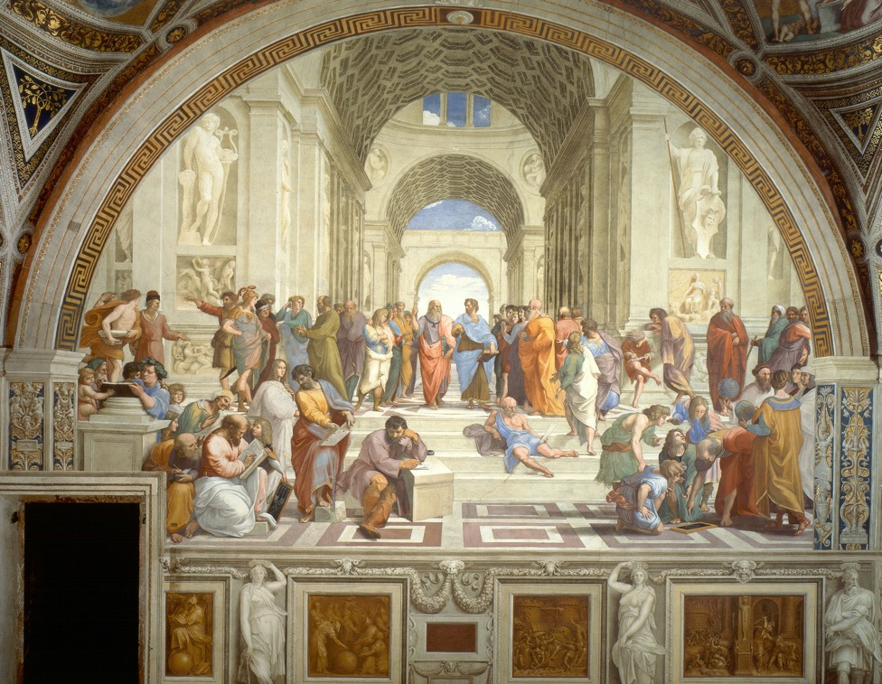
Introductions
By Raphael - Stitched together from vatican.va, Public Domain, https://commons.wikimedia.org/w/index.php?curid=4406048
Notes:
We welcome cats and babies
First run. Mandatory from August. So we are really interested to know:
Open questions
Who?
Where?
What they want to get out of the day?
Why applied? (To inform future runs)
Have you done TTT?
And evaluation
Image
The School of Athens by Raphael. Wikimedia Commons marked for re-use.
A fresco by the Italian Renaissance artist Raphael. It was painted between 1509 and 1511 as a part of Raphael's commission to decorate the rooms now known as the Stanze di Raffaello, in the Apostolic Palace in the Vatican. This picture is repeated at the end under Reflection and Review where it can be used to summarise the day.

Slide 5
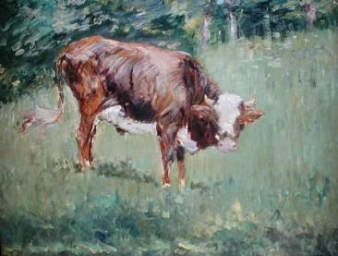
Aims
To provide an overview of ethical theories and practise using them to disentangle real-life issues
Notes:
Background information for trainers
Picture is by Edouard Manet. Young Steer in a Field. Wikimedia, marked for re-use.

Slide 6

The Curriculum
HLO 3: A professional, responsible for their own practice and portfolio development
11. Ethics and Law: Demonstrate professional practice in line with the curriculum, GMC and other statutory requirements through development of a professional portfolio 12. Continuing Professional Development: Develop practice including the acquisition of new knowledge and skills through experiential learning; acceptance of feedback and, if necessary, remediation; reading and, if appropriate, by research 13. Understanding Medicine: Understand the breadth of medical practice and plan a career
Notes:
Discuss
This is the curriculum from Aug 2021
Background information for trainers

Slide 7

Ethics in healthcare
“In many situations in which the doctor finds themselves, uncertainty will likely exist and it is the role of the doctor … to make decisions on care based on sound ethical principles using personal knowledge and skills, evidence and scientific training.”
Foundation Programme Curriculum
Notes:
Discuss
We are taking an approach today based on principles not just codes of practice (see Definitions slide)
Background information for trainers

Slide 8
Objectives for the day
By the end of the day, you will be able to:
Define ethics
  And understand the differences from related terms such as morals and belief systems
Describe the three major groups of ethical theories
Formulate a complex response to a current ethical issue in terms of these theories
Use a simple and memorable schema to approach ethical problems
Notes:
Emphasise
These objectives / learning outcomes are consistent with the Foundation Programme curriculum
Background Information for trainers
A lot of authors would now use the term ‘learning outcomes’ here rather than ‘objectives’. See for example the overview at https://academicdevelopment.qmul.ac.uk/wp-content/uploads/2014/05/Aims-and-Outcomes-Guide.pdf. The ‘objectives’ described here are phrased as learning outcomes, but we have retained the term objectives for consistency with other Deanery teaching materials.

Slide 9
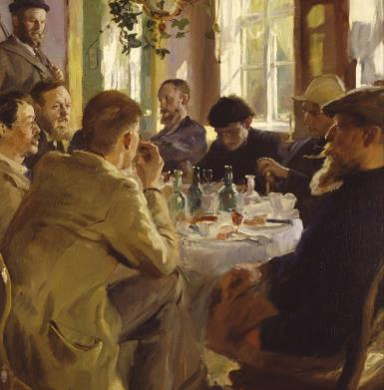
Principles of Education
“Small group workshops to consolidate knowledge, teach reasoning and explore new topics in more detail”.
Foundation Programme Curriculum
Notes:
Background information for trainers
Image
P.S. Krøyer: Artists at Lunch (1883) from Wikipedia, also the image used for small group teaching in the TTT for F2 slide set.

Slide 10
Programme for the day
Session
10.00 Start | Welcome, introductions, ground rules
1. | Definitions
2. | Major ethical systems
3. | A current dilemma and discussion
4 | Ethical systems revisited
12.30 ish lunch
5. | A simple practical approach
6. | A problem from the MDU and discussion
16.00 (or earlier) End
10-minute breaks every hour ish
Notes:
Background information for trainers

Slide 11

Activity!
In groups - 20 minutes
What are:
Ethics
Morality
Culture
Values
Belief systems
Religions
Conspiracy theories
Notes:
Discuss
Probably two groups. Allow 20 minutes discussion, 10 minutes feedback and then work through the list below.
Feedback - Encourage the participants not only to prevent the consensus definition within their group but also any disagreements
Definitions mostly from Oxford Concise Dictionary
Ethics
1. Relating to morals
2. Set of principles of morals
3. =‘Moral philosophy’
Note that ‘Ethics’ is often used to mean ‘Codes of practice’ e.g. ‘Business Ethics’ and often ‘Medical Ethics’. Today we are interested in tying together Moral Philosophy with codes of practice.
Morals
L moris = custom. Can be descriptive or normative. ‘The morals of South Sea Islanders permit cannibalism’- descriptive. ‘Thou shalt not kill’ – normative..
In some cultures (see below) used particularly of matters relating to sexual behaviour.
Culture
1. The ideas, customs, and social behaviour of a particular people or society.
"Afro-Caribbean culture” (Oxford Languages on line).
2. “How things are done around here” – can relate to a very small group of people ‘The culture of this Department is…’
Beliefs and values
A way of describing motivations. Commonly based on culture and education. Often unexamined but people tend to think that their beliefs and values are rationally based and are held by all reasonable people. They are usually wrong.
Belief system
An ordered and internally coherent set of beliefs. May be predominantly religious (e.g. 1. Islam, 2. Christianity etc.) or non-religious (e.g. 1. atheist-secular-humanist, 2. Stoic).
Religions
Belief systems typically with a supernatural element, may or may not emphasise an afterlife.
Usually provide social cohesion and normative ethical theory. Not always – Ancient Greek and Roman state religions (Zeus / Jupiter and the rest) had little belief in afterlife and no normative ethical theory. Very important for social cohesion, so the Roman Empire persecuted ‘Atheist’ Christians at times when the Empire was threatened.
Conspiracy theories
Conspiracy theories differ from belief systems by lack of internal consistency (Princess Diana died in an attempted faked death that went wrong AND she was killed on the orders of Prince Philip) and immunity to evidence ‘MI6 proved that there was no plot to kill Princess Diana’ ‘Ah then MI6 must be part of the plot’. AntiVax theories are similar.
Background Information for trainers
Conspiracy theories:
Contradictory (internally non-coherent)
Over-riding suspicion
Nefarious intent
Something Must Be Wrong
Persecuted Victim
Immune to evidence
Reinterpreting randomness
Conspiracy Theory Handbook Stephan Lewandowsky and John Cook. University of Bristol 2021

Slide 12
Feedback
What are:
Ethics
Morality
Culture
Values
Belief systems
Religions
Conspiracy theories
Notes:
Discuss
May 2021 experience is that using the participants own slides and after each topic trainer reviews, before moving on to the next topic works well.
Encourage the participants not only to prevent the consensus definition within their group but also any disagreements
Definitions mostly from Oxford Concise Dictionary
Ethics
1. Relating to morals
2. Set of principles of morals
3. =‘Moral philosophy’
Note that ‘Ethics’ is often used to mean ‘Codes of practice’ e.g. ‘Business Ethics’ and often ‘Medical Ethics’. Today we are interested in tying together Moral Philosophy with codes of practice.
Morals
L moris = custom. Can be descriptive or normative. ‘The morals of South Sea Islanders permit cannibalism’- descriptive. ‘Thou shalt not kill’ – normative..
In some cultures (see below) used particularly of matters relating to sexual behaviour.
Culture
1. The ideas, customs, and social behaviour of a particular people or society.
"Afro-Caribbean culture” (Oxford Languages on line).
2. “How things are done around here” – can relate to a very small group of people ‘The culture of this Department is…’
Beliefs and values
A way of describing motivations. Commonly based on culture and education. Often unexamined but people tend to think that their beliefs and values are rationally based and are held by all reasonable people. They are usually wrong.
Belief system
An ordered and internally coherent set of beliefs. May be predominantly religious (e.g. 1. Islam, 2. Christianity etc.) or non-religious (e.g. 1. atheist-secular-humanist, 2. Stoic).
Religions
Belief systems typically with a supernatural element, may or may not emphasise an afterlife.
Usually provide social cohesion and normative ethical theory. Not always – Ancient Greek and Roman state religions (Zeus / Jupiter and the rest) had little belief in afterlife and no normative ethical theory. Very important for social cohesion, so the Roman Empire persecuted ‘Atheist’ Christians at times when the Empire was threatened.
Conspiracy theories
Conspiracy theories differ from belief systems by lack of internal consistency (Princess Diana died in an attempted faked death that went wrong AND she was killed on the orders of Prince Philip) and immunity to evidence ‘MI6 proved that there was no plot to kill Princess Diana’ ‘Ah then MI6 must be part of the plot’. AntiVax theories are similar.
Background Information for trainers
Conspiracy theories:
Contradictory (internally non-coherent)
Over-riding suspicion
Nefarious intent
Something Must Be Wrong
Persecuted Victim
Immune to evidence
Reinterpreting randomness
Conspiracy Theory Handbook Stephan Lewandowsky and John Cook. University of Bristol 2021

Slide 13
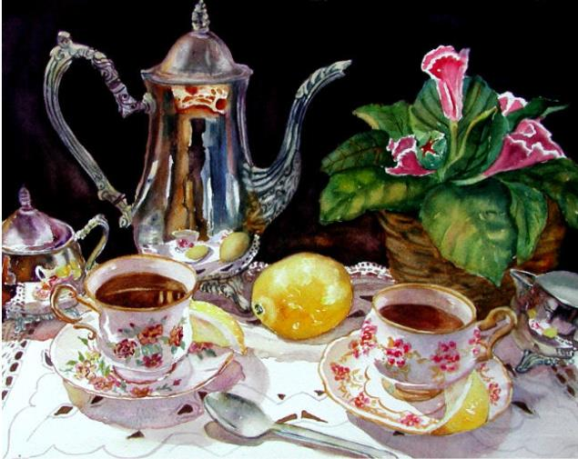
Break
Notes:
10 mins break, agree specific time to restart

Slide 14
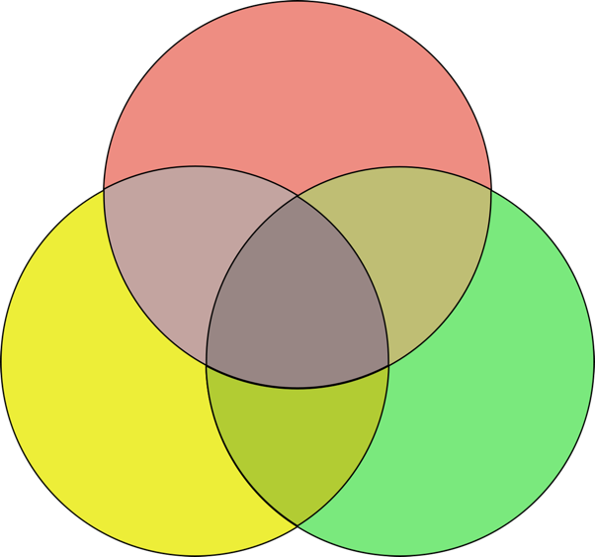
Three main approaches
Virtue
  4 cardinal virtues
Rights and Duties
  Deontological
Consequences
  Utilitarianism
Notes:
Discuss
We are going to be talking about Virtues in more detail. The 4 cardinal virtues we are using were developed from Aristotle and Stoicism.
Background information for trainers
These approaches are dealt with in the following slides
Aristotle described 12 virtues; the Stoics simplified this to 4. Medieval Christianity adopted the 4 virtues but added the 3 ‘Theological’ virtues of Faith, Hope and Charity. This can be discussed later

Slide 15
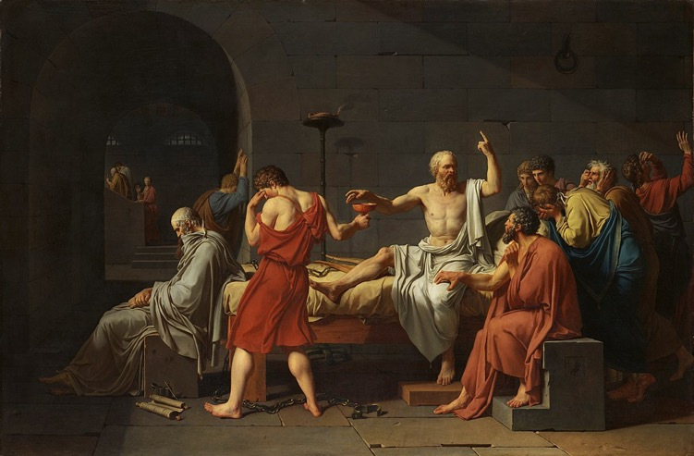
Socrates – 5th C BCE
Pre-Socratic
  Pythagoras and Democritus
Socrates
  Plato and Aristotle
Hellenistic Schools
  Stoicism
Other traditions
  Buddhism, Daoism, Confucianism
By Jacques-Louis David - https://www.metmuseum.org/collection/the-collection-online/search/436105, Public Domain, https://commons.wikimedia.org/w/index.php?curid=28552
Notes:
Discuss
Easy to get bogged down in detail here – this slide should take less than a minute and just hit the high points
This is the core of everything you will ever need to know about ancient philosophy on a single slide!
Socrates as chronological central character (died 400 BC more-or-less)
1.. Socrates, Plato, Aristotle. Polymaths. Interested among other things on how to live a Good Life – Eudaimonia – see later.
Aristotle was tutor to Alexander the Great
2. Pre-Socratic – non-religious exploration of ‘What is the Universe all about?’ Pythagoras – number. Democritus – atoms. Various confusingly named others – Heraclitus, Anaximander, Anaximenes etc. Earth, Air, Fire and Water.
3. Hellenistic period. Successor Empires and Kingdoms after the death of Alexander 323 BCE through to Battle of Actium 31 BC (Octavian v Cleopatra VI).
Roman Empire then dominates the Western world until fall of Rome in 476 CE.
Byzantine Empire continues to Fall of Constantinople in 1453 CE.
4. Buddha roughly co-chronological with Socrates: thought to have been active around 400 BCE. Lots of interesting similarities between Stoicism and Buddhism but uncertain how much this is actual contact or social convergent evolution.
5. Confucius slightly earlier: 551-479 BCE
Background information for trainers
Ancient philosophy still read and discussed
Religion had little to do with Ethics
Socrates 470 – 399 BC
Image
Death of Socrates by Jacques-Louis David. Taken from Wikipedia and marked for re-use.

Slide 16
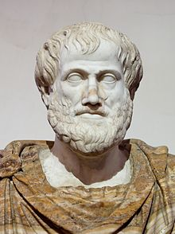
Classical Virtues
Aristotle
Eudaimonia
  Flourishing
  Self-actualization
Arete
  Virtue
  Skills
Notes:
Discuss
Eudaemonia – the ‘Flourishing Life
Eu = ‘balanced’ as in euthyroid. In this instance means more ‘Where it should be’ than ‘In the middle’. Daimon (or daemon) = spirit. Cf Philip Pullman ‘His Dark Materials’ and externalised daemons.
Not in anything I have read but equates well to Maslow’s self-actualization.
Similarly Arete = Virtue but not as in holy or charitable, more in the sense that ‘Solidity is a virtue in a house’ or ‘Speed is a virtue in an athlete’. When used of humans has elements of something innate but also something that can be practised and perfected. In modern educational parlance this is more like ‘It is a virtue in a teacher to be skilled in lesson planning’.
Background information for trainers
These ideas go back to Socrates and Plato (The Republic) but are commonly referred to as Aristotelian,
Aristotle
Born 384 BC in Macedon. Died 322 BC (aged 61–62)
Taught by Plato
Founded the Lyceum, the Peripatetic school of philosophy, and the Aristotelian tradition
Described his ‘Virtues’ in several works, notably the ‘Nicomachean Ethics’. 12 virtues sounding suspiciously like a description of an educated Greek chap i.e like Aristotle! Either too much or too little can be a vice (e.g. bravery)
Tutor to Alexander the Great
Influenced Judeo-Islamic philosophies (800–1400) during the Middle Ages, as well as Christian theology, especially the Neoplatonism of the Early Church and the scholastic tradition of the Catholic Church.
Revered among medieval Muslim scholars as "The First Teacher" and among medieval Christians like Thomas Aquinas as simply "The Philosopher".
His ethics gained renewed interest with the modern advent of virtue ethics.
Image
Bust of Aristotle. Marble, Roman copy after a Greek bronze original by Lysippos from 330 BC; the alabaster mantle is a modern addition.
Taken from Wikpedia: https://en.wikipedia.org/wiki/Aristotle and in the public domain.

Slide 17
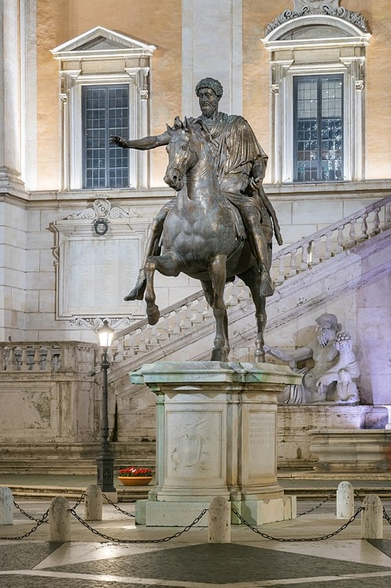
How to Think Like a Roman Emperor
Marcus Aurelius
1 | Humans have intellect Wisdom / rationality Making good decisions
2 | Relationship to others Justice
3&4 | Relationship to events What is under my control? Action! Courage and moderation
© Albert Bridge
Notes:
Discuss
Stoicism provided the major ethical system of educated Greeks and Romans from about 300 BCE to 400 CE. Not just stoicism (small s) as in Mr Spock and emotionless coping-style: ‘stiff upper lip’.
A wide-ranging theory of a rational universe with a simple but very influential version of the virtues.
Marcus Aurelius d 180 CE. The ‘Good Emperor’ in Gladiator.
Intellect is what divided humans from all other animals (Socrates and Aristotle). Relationship to self - Wisdom
Relationship to others – Justice
Relationship to events. Courage and Moderation, have to do with mastering our fears and desires, and our ability to cope rationally with the events that befall us in our daily lives. Moderation: Not too much nor too little: courage but not cowardice nor foolhardiness. Managing competing priorities: climate change activism AND studying for exams.
A philosophy of ethics and action
Background information for trainers
This particular ‘take’ on the cardinal virtues is directly derived from late (Roman) Stoicism and the ‘Meditations’ of Marcus Aurelius. See ‘How to Think Like a Roman Emperor: The Stoic Philosophy of Marcus Aurelius’
by Donald Robertson – Cognitive psychotherapist 2019 #1 Best Seller in Greek & Roman Philosophy. Amazon UK. Also see Philip Hadot ‘The Inner Citadel’
Image
Equestrian statue of Marcus Aurelius Sébastien Bertrand from Paris, France https://commons.wikimedia.org/w/index.php?search=Marcus+aurelius&title=Special:MediaSearch&go=Go&type=image taken from Wikimedia Commons and marked for re-use.

Slide 18
Three main approaches
Virtue
  4 cardinal virtues
Rights and Duties
  Deontological
Consequences
  Utilitarianism
Notes:
Discuss
Brief re-iteration of the overview

Slide 19
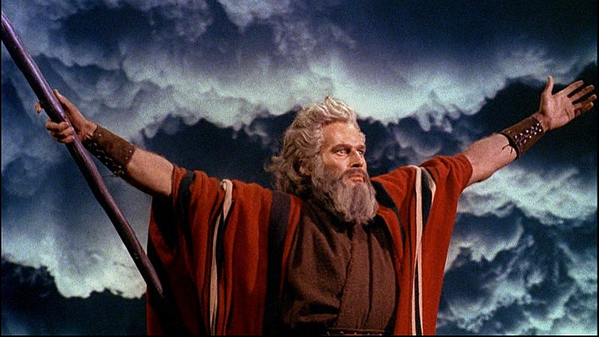
The Ten Commandments
313 CE Constantine the Great decriminalized Christianity
380 CE Theodosius 1 made Christianity the state religion
529 CE Justinian closed the Athenian philosophical schools
Duties:
8 ‘Shall not’s’, 2 ‘Shall’s’
‘Divine Command Theory’
Notes:
Background information for trainers
313 CE Edict of Milan
380 CE Edict of Thessalonica
Christian traditions and ethics
Example of difference from Stoicism: Cato the Younger was a role model for Stoics for committing suicide (very messily) rather than allowing himself to be captured by Julius Caesar after the Battle of Thapsus (46 BCE)
Image
Charlton Heston as Moses in The Ten Commandments. (Yul Brynner as Pharoah Ramses II). From Wikimedia Commons marked for re-use.

Slide 20
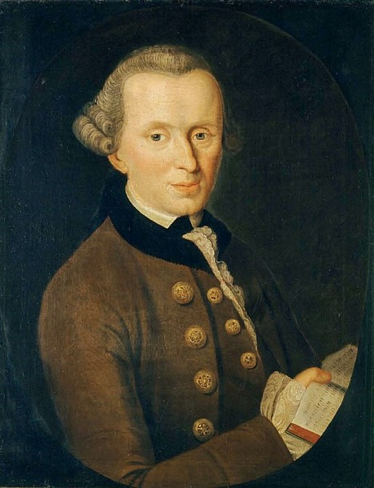
Deontology
Immanuel Kant (1724 – 1804)
The Categorical Imperative:
Derived from Reason
Intrinsically valid
Good in and of themselves
Must be obeyed in all situations and circumstances
By Johann Gottlieb Becker (1720-1782) - http://www.philosovieth.de/kant-bilder/bilddaten.html, Public Domain, https://commons.wikimedia.org/w/index.php?curid=32860677
Notes:
Discuss
Focus is on the motives lying behind an action
Difficulty of all situations and circumstances
Background information for trainers
(from Greek: δέον, 'obligation, duty' + λόγος, 'study’)
Kant developed his moral philosophy in three works: Groundwork of the Metaphysic of Morals (1785), Critique of Practical Reason (1788), and Metaphysics of Morals (1797).
There is a single moral obligation; the ‘Categorical Imperative’ derived from the concept of duty
good in and of themselves
must be obeyed in all situations and circumstances
So if you believe that telling the truth is a moral obligation then when the Gestapo ask “Are you sheltering any Jews?” you have to tell the truth. Or if you give to a beggar purely out of compassion for that individual – it is not a moral act
There are several other other deontological theories including modern versions: Thomas Nagel, T. M. Scanlon, and Roger Scruton.
The principle of rationally derived duties underlies UK Law and Professional codes of Practice such as GMC documents (next slide)
Image
from Wikipedia marked for reuse

Slide 21
Meta-ethics
Naturalism
  Ethics follows facts – e.g. hedonic calculus
Moral relativism
  E.g. Aristotle defended slavery
Emotivism
  Ethical statements are just preferences
Notes:
Background information for trainers
It is not intended that this slide should be used. It is included in case the topic comes up and/or there is time to discuss it. Both are unlikely

Slide 22
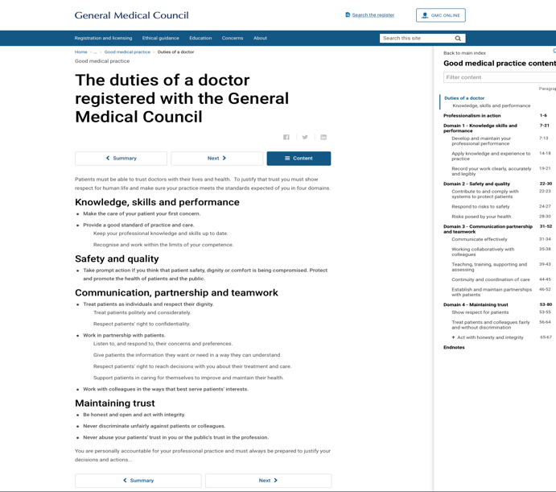
Duties
The NHS
“The primary legal duties on CCGs and NHS England is imposed by section 3(1) of the NHS Act, namely to “arrange for the provision” of a wide range of health services “to such extent as it considers necessary to meet the reasonable requirements of the persons for whom it has responsibility”.
An Introduction to the Legal Structures of the NHS - Landmark Chambers.co.uk › 2018/06 › I...
Notes:
Discuss
The principle or rationally derived duties underlies The Law and Professional codes of Practice such as GMC documents
Background information for trainers
Note that religiously derived duties are still of huge importance:
Non-separation of Church and State, Bishops in the House of Lords, ruling elite from Eton and Cambridge / Oxford – explicitly Christian in the not-very-recent past.
More pervasive general sense of historical Christian culture in the UK,
Other religious influences – e.g. Sharia Law

Slide 23
Three main approaches
Virtue
  4 cardinal virtues
Rights and Duties
  Deontological
Consequences
  Utilitarianism
Notes:
Discuss
Brief re-iteration of the overview

Slide 24
Consequentialism
Socrates and Crito
My children
The State
Louvre. Bust of the Greek orator Demosthenes. Marble, Roman artwork, inspired from a bronze statue by Polyeuctos (ca. 280 BC). Found in Italy.
Notes:
Discuss
The problem is that one can never know in advance whether an action is right or wrong.
Stealing is wrong
Stealing from the rich to give to the poor?
Does giving to the poor erode self-reliance?
So – What is good?
Background information for trainers
Image
From Wikipedia marked for re-use

Slide 25
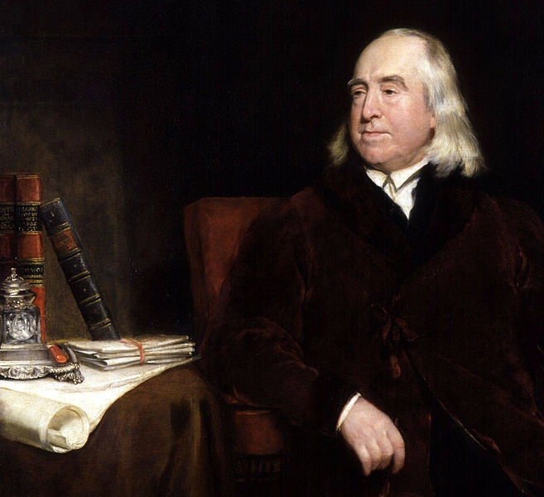
Utilitarianism
Jeremy Bentham (1748 – 1832)
‘The Greatest Happiness of the greatest number’
Hedonic Calculus
By Henry William Pickersgill (died 1875)
Notes:
Discuss
The hedonic calculus:
12 pains and 14 pleasures
Intensity, duration, certainty, proximity, productiveness, purity, and extent.
Also John Stuart Mill – Victorian social reformer
Image
Taken from Wikimedia and marked for re-use.

Slide 26
Three main approaches
Virtue
  4 cardinal virtues
Rights and Duties
  Deontological
Consequences
  Utilitarianism
Notes:
Discuss
Brief re-iteration of the overview

Slide 27

Virtue Ethics regenerated
Am I a Good Man Clara?
© BBC
Notes:
Discuss
Doctor Who Series 8, 2014. Peter Capaldi as the 12th Doctor trying to make sense of his new regeneration.
“Am I a Good Man?” is a Virtues based question. He is not asking ‘What rules should I obey?’ nor ‘How do I determine the consequences of my actions?’. Not an idle use of the phrase; see the next slide.
Background information for trainers
Although some Enlightenment philosophers (e.g. Hume) continued to emphasise the virtues, with the ascendancy of utilitarianism and deontology, virtue theory moved to the margins of Western philosophy.
The contemporary revival of virtue theory is frequently traced to the philosopher Elizabeth Anscombe's 1958 essay "Modern Moral Philosophy". Following this: Alasdair MacIntyre has made an effort to reconstruct a virtue-based theory in dialogue with the problems of modern and postmodern thought; his works include After Virtue and Three Rival Versions of Moral Enquiry.
Psychologist Martin Seligman drew on classical virtue ethics in conceptualizing Positive psychology.
Abridged from Wikipedia
Image
BBC website

Slide 28
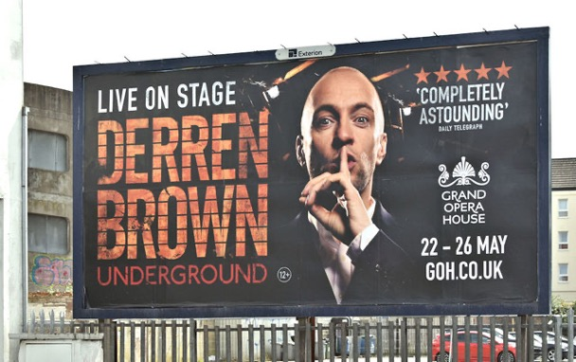
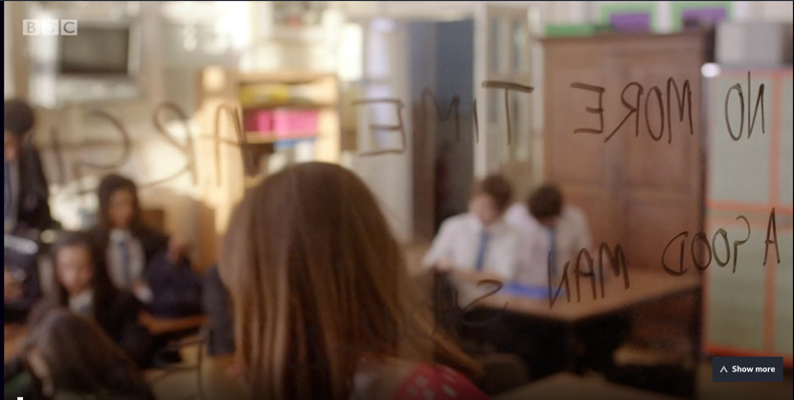
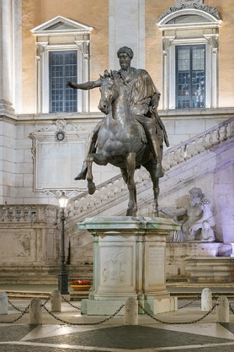
Modern Stoicism
“Spend no more time asking how to be a good man. Be one!”
https://www.geograph.ie/photo/5780580
© BBC
© Albert Bridge
Notes:
Background information for trainers
1.The quote is opening words of the 50th anniversary edition of Dr Who – so important to BBC script writers. It is a direct quote from Marcus Aurelius’s Meditations.
2. Derren Brown is also the author of ‘Happy – Why more or less everything is absolutely fine’ (2016) an excellent book largely about Stoic philosophy.
Images
Dr Who. BBC – screenshot from YouTube
Equestrian statue of Marcus Aurelius Sébastien Bertrand from Paris, France https://commons.wikimedia.org/w/index.php?search=Marcus+aurelius&title=Special:MediaSearch&go=Go&type=image taken from Wikimedia Commons and marked for re-use.
Derren Brown – taken from Geograph.ie. © Copyright Albert Bridge and licensed for reuse under this Creative Commons Licence.

Slide 29

The Good Place
© Express.co.uk
Notes:
Image
Express.co.uk
Background Information for Trainers
Netflix 2016
Several critics have commended the show for its exploration and creative use of ethics and philosophy.^{[66][1][67]} Featured topics include the trolley problem thought experiment originally devised by Philippa Foot,^{[68][69]} the categorical imperative first formulated by Immanuel Kant,^{[69][70]} T. M. Scanlon's What We Owe to Each Other,^{[71]}and the works of Aristotle and Søren Kierkegaard.^{[69][72]} Andrew P. Street of The Guardian wrote that "moral philosophy is the beating heart of the program" and that the show "made philosophy seem cool."^{[70]} Elizabeth Yuko of The Atlantic noted that "The Good Place stands out for dramatizing actual ethics classes onscreen, without watering down the concepts being described, and while still managing to be entertaining."^{[69]} For their part, several philosophers have celebrated the show's largely accurate popularization of their line of work,^{[1]} while noting some minor inaccuracies.^{[72] (Wikipedia)}

Slide 30
How to live ethically in a pandemic
Virtue
  4 cardinal virtues
Rights and Duties
  Deontological
Consequences
  Utilitarianism
Notes:
Discuss
Background information for trainers
Image
Venn diagram: https://www.google.com/url?sa=i&url=https%3A%2F%2Fen.wikipedia.org%2Fwiki%2FFile%3AVenn_diagram_coloured.svg&psig=AOvVaw3KEcqpyqgy9HD37hZUifsn&ust=1618751458205000&source=images&cd=vfe&ved=0CA0QjhxqFwoTCLDJi7OthfACFQAAAAAdAAAAABAD
From Wikipedia – in the public domain

Slide 31
Break
Notes:
10 mins break, agree specific time to restart

Slide 32
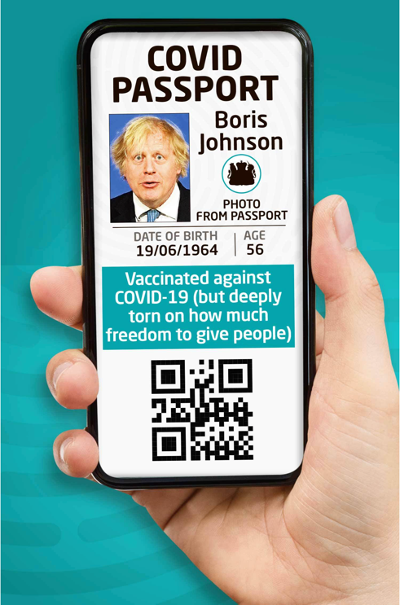
Activity! Should we have to carry COVID passports?
Split into teams – 20 minutes
  Team 1 – Virtues
  Team 2 – Duties
  Team 3 – Consequences
Each team 5-minute presentation:
  Arguments for and against
  A conclusion
  Strengths and weaknesses of this ethical system
© The Sun
Notes:
To consider timing – could easily spend 30 minutes on this exercise and 30 minutes discussion
Explain that the participants will divide into teams as in the slide. Each team will consider the question purely according to their team’s ethical approach and then present their conclusions in a 5 minute session.
Background Information for trainers
Image is from The Sun online. We don’t have copyright but this topic is likely to change anyway in future runs

Slide 33
Presentations
Team 1 – Virtues
Team 2 – Duties
Team 3 – Consequences
5-minutes:
Arguments for and against
A conclusion
Strengths and weaknesses of this ethical system
© The Sun
Notes:
To consider timing – could easily spend 30 minutes on this exercise and 30 minutes discussion
Background Information for trainers
Image is from The Sun online. This topic is likely to change anyway in future runs

Slide 34
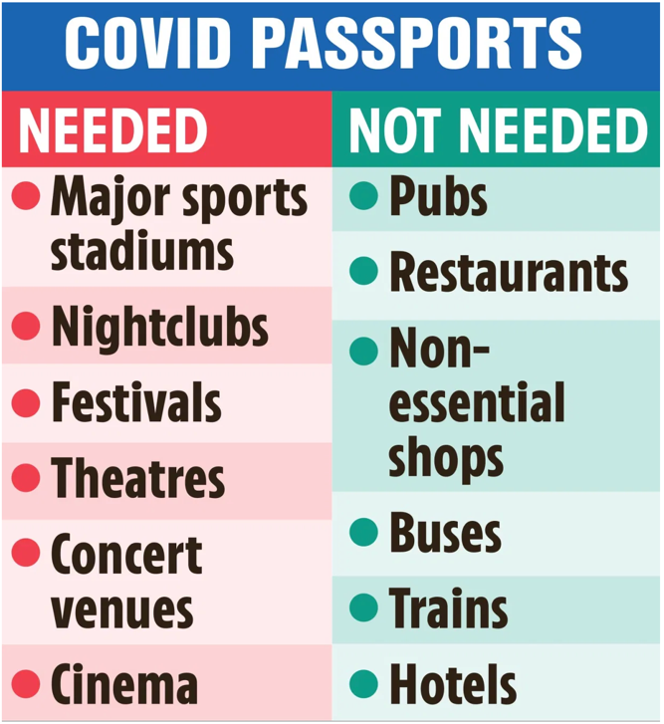
How well was the question framed?
When?
Where?
Who?
  Are there different rules for Health Service workers (you!)?
© The Sun
Notes:
Background information for trainers
Analytical and linguistic philosophy:
Bertrand Russell Principia Mathemetica (Echoes Newtons Principia )
Ludwig Wittgenstein Tractatus Logico-Philosophicus
AJ Ayer – ‘Language Truth and Logic

Slide 35

Who decides on the Virtues?
Classical eudaemonia
  Aristotle – Virtue & externals
  Stoicism – Virtue alone
Buddhist brahmavihārās
  Loving kindness, Compassion, Empathetic joy and Equanimity
Christian
  Faith, Hope and Charity
Islam
  Honesty, Kindness and Charity
© BBC
Notes:
Background information for trainers
Note pun on Who?
These next few slides should build on the problems associated with each theory as identified by the participants in the preceding activity
Classical
Eudaemonia – ‘flourishing’
Arete - the sense of ‘virtue' operative in ancient ethics is not exclusively moral and includes more than states such as wisdom, courage and compassion. The sense of virtue which areté connotes would include saying something like "speed is a virtue in a horse", or "height is a virtue in a basketball player". Wikipedia
Socrates - Virtue is both necessary and sufficient for eudaimonia. Socrates is convinced that virtues such as self-control, courage, justice, piety, wisdom and related qualities of mind and soul are absolutely crucial if a person is to lead a good and happy (eudaimon) life. (From early writings of Plato)
Plato - The Republic - virtue is depicted as the most crucial and the dominant constituent of eudaimonia
Aristotle - Nicomachean Ethics and the Eudemian Ethics. In outline, for Aristotle, eudaimonia involves activity, exhibiting virtue (aretē sometimes translated as excellence) in accordance with reason. (Wikipedia). But eudaemonia requires virtue and luck / external factors - wealth and health
Epicurus - Eudaemonia is happiness - simple pleasures and the avoidance of pain - so avoid public life
Zeno (Stoicism) - Virtue is necessary and sufficient for eudaimonia. (This thesis is generally regarded as stemming from the Socrates of Plato's earlier dialogues.)
Eudaemonia is the moral life i.e. virtue
Hood
Aspects of happiness:
Positive emotions - 'happiness’
Engagement - Eudaemonia
Meaningful life
Note that engagement and meaning is more Stoic than Epicurean
Christian – 3 theological virtues are added to the 4 classical virtues
Buddhism – 4 abodes
Islam – 5 pillars Faith, Prayer, Alms, Fasting and Pilgrimage
Note also:
Christian Ten Commandments
Buddhist Eightfold Path: right view, right resolve, right speech, right conduct, right livelihood, right effort, right mindfulness, and right samadhi ('meditative absorption or union’)
Islam: Teachings on morality and moral conduct constitute a major part Islamic literature. The Quran and the Hadith – the central religious texts of Islam – serve as the primary source for these teachings.^{[3]} Both the Quran and the hadith often instruct Muslims to adopt a morally upright character. Showing kindness to people and charity to the poor and the helpless are the most emphasized moral virtues in the Quran.^{[4]} In particular, helping people in their time of need, forgiving others' offenses, respecting parents and elders, fulfilling promises, being kind to people and to animals, being patient in adversity, maintaining justice, being honest, and controlling one's anger appear as major virtues in the Islamic concept of morality. (Wikipedia)

Slide 36

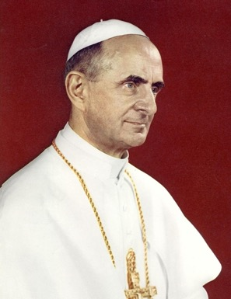


Only Connect
Rob Stothard / Getty Images
HUMANAE
VITAE
1968
Notes:
This slide was not used in May 2021 – sacrificed to time constraints
Discuss
Divine Command Ethics – many people’s ethical systems are derived from religion but whose religion should we use?
If you ask your friends what their ethical systems are few will mention Aristotle, Kant or Bentham. Some will be explicitly religious, many of the others will have ideas derived from their upbringing or schooling.
Examples of conflicts
Humanae Vitae. Pope Paul VI rejected artificial contraception
Blood bag – Jehovah’s Witnesses
Assisted Dying
As many as 80% of the UK public support legal assisted dying. Opposition from medical organisations such as the RCP is reducing. Christian churches remain opposed.
4. Other religious views, including atheism are now common in the UK.
Background information for trainers
Christianity is an important religious belief / ethical system influencing even for those who are not Christian. Influence in all countries under the Roman and Byzantine Empires and the later European empires: British, Belgian, French, Spanish, Portuguese and on and on.
Images
Pope Paul VI – Official portrait. Wikimedia marked for re-use
Assisted dying – Rob Stothard / Getty Images – taken from The Times https://www.thetimes.co.uk/article/assisted-dying-backed-by-87-per-cent-of-scots-poll-shows-t2fccxwdf
Blood bag – taken from Wikimedia Commons and labeled for re-use

Slide 37
Utilitarianism
Jeremy Bentham (1748 – 1832)
‘The Greatest Happiness of the greatest number’
Hedonic Calculus
But what about Justice?
By Henry William Pickersgill (died 1875)
Notes:
Discuss
The hedonic calculus:
12 pains and 14 pleasures
Intensity, duration, certainty, proximity, productiveness, purity, and extent.
Criticisms
Are all pleasures equal?
No sense of justice – is it OK to torture terrorists?
Rule utilitarianism can act as the basis for Duties.
Background information for trainers
Many commentators believe that Bentham had Asperger’s syndrome
Image
Taken from Wikimedia and marked for re-use.

Slide 38
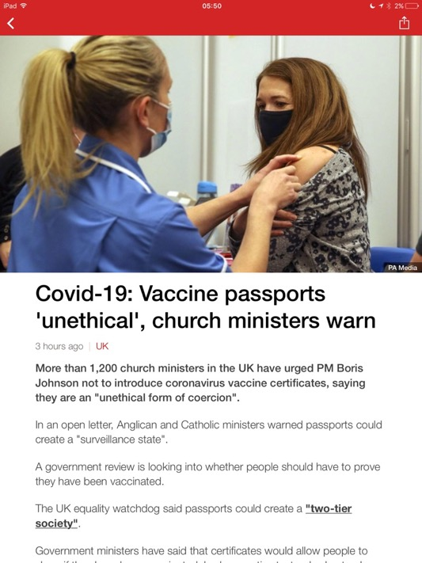
What ethical system is this?
Notes:
Background information for trainers
Consequentialism – surprising from church ministers? Possibly different from the conclusions the trainees came to – if so is this an aspect of our culture?
May 2021 - it seemed a long time before anyone got this. Perhaps its difficult to read and the phrase “ministers warned passports could create a ‘surveillance state’” needs to be read out. And/or the participants need to be guided to the notion that this is about the consequences of public policy.

Slide 39
In practice:
Virtue
  4 cardinal virtues
Rights and Duties
  Deontological
Consequences
  Utilitarianism
Notes:
Discuss
In practice:
Public policies
Consequentialism is used to consider greatest good for greatest number
Deontology - rationally derived but also ‘legacy Divine Command’: in the UK - Christian traditions are sometimes brought into play – see the Only Connect’ slide
Encoded in laws and guidelines (including Medical Ethics) as
Duties
Personal Ethics
Often derived from parents, schooling, culture. Seldom explicitly thought through. May have a strong derivation from Divine Command on inspection.

Slide 40
Break?
Notes:
Background information for trainers
The picture is Monet. Still Life with Grapes 1880. On Wikimedia commons and labelled for re-use.

Slide 41
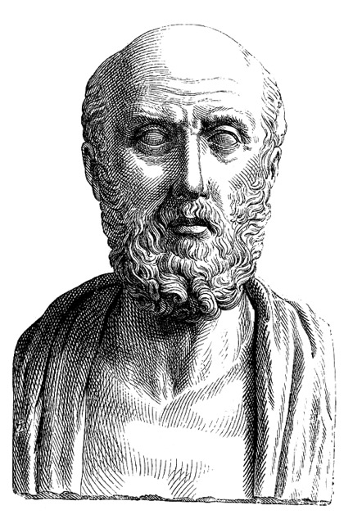
Ethics in Practice
Medical Ethics
Autonomy | Capacity, consent and shared decision making
Justice | Listening and understanding the other persons point of view The rules – Law and GMC (Deontology)
Beneficence | Clear explanations of risk and benefits
Non-maleficence | The bigger picture (Consequentialism)
Tom Beauchamp and James Childress (1985) – Four principles approach Principles of biomedical ethics
Gillon, R (1994). "Medical ethics: four principles plus attention to scope". British Medical Journal. 309 (184): 184–188.
By Unidentified engraver - 1881 Young Persons&#039; Cyclopedia of Persons and PlacesUpload by RedWolf 05:45, Jan 10, 2005 (UTC), Public Domain, https://commons.wikimedia.org/w/index.php?curid=164808
Notes:
Discuss
The. Ethical theories are like learning anatomy and physiology – necessary but you need a bit more for medical practice – analogous to NICE guidelines
First 3 fit with the classic virtues of Justice and Wisdom
Non-maleficence fits with Consequentialism
The actual rules are deontological – law and the GMC.
Background information for trainers
Derived from:
Basic Theories – as discussed
The Law
GMC – Good Medical Practice
Historically
Hipppocratic Oath – 5th C BCEish although first written record 245 CE. Possibly written by Pythagoreans. More of a set of rules for a Craft Guild. Public always remember this one – few doctors actually take it, some take a modified version.
Note:
‘To hold my teacher in this art equal to my own parents; to make him partner in my livelihood; when he is in need of money to share mine with him; to consider his family as my own brothers, and to teach them this art, if they want to learn it, without fee or indenture; to impart precept, oral instruction, and all other instruction to my own sons, the sons of my teacher, and to indentured pupils who have taken the Healer’s oath, but to nobody else.’
And
‘I will not use the knife, not even, verily, on sufferers from stone, but I will give place to such as are craftsmen therein.’
Declaration of Helsinki 1964 – cornerstone of human research ethics
Image
Hippocrates – taken from Wikipedia and labelled for re-use

Slide 42
Break
Notes:
Background information for trainers
The picture is Monet. Still Life with Grapes 1880. On Wikimedia commons and labelled for re-use.

Slide 43
Confidentiality
What problems have you seen?
What concerns you?
Has the pandemic made a difference?
Notes:
Topics to discuss
HIV and disclosure to partner – ethics change with changing treatment – so Consequences important
Testing for Huntingdon’s Chorea
Image
As before

Slide 44
Break
Notes:
10 mins break, agree specific time to restart

Slide 45
Case study – HIV
Partner notification
You are an F2 in Sexual Health. John presents with a new diagnosis of gonorrhoea. You discover he was diagnosed with HIV last year.
He has not told his long-term partner about his HIV diagnosis.
Notes:
Initial discussion

Slide 46
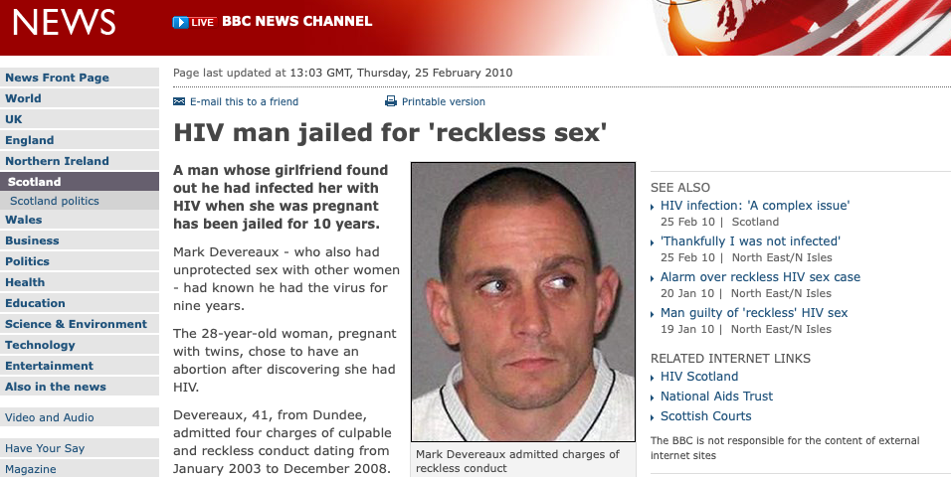
Case study – HIV
What if…?
The (criminal) law
Notes:
Then add in factors that might change their thinking/are prompts for discussion:
Would it matter if John had refused treatment? (he could have a high viral load, and therefore be putting his partner at risk)
Would it change anything if John had never come back for his HIV result, but knew he was tested? (might legally? But practically it doesn’t – pretty much the same as the above)
Would it change things if you were a GP, and John and his partner were both patients at your practice? (duty of care to his partner as well as John)
Would it be different if he was a woman and had had a child since being diagnosed with HIV, but had not notified his partner or arranged testing for the child?
Do you think that breaching John’s confidentiality might have its own adverse effects?
The UK law
If the person is shown to
Know that harm might arise from having unprotected sex whilst HIV positive, but continues to do so (mens rea – recklessness). So they need to understand HIV transmission and fail to take measures to mitigate it
Be the source of the HIV infection (actus reus - GBH)
There was no consent by the injured party to the risk of harm
Or, if the person intended to transmit HIV to the individual and did, there is no defence of consent
As it’s been tested in the courts, you basically have to disclose your HIV diagnosis in order to run a consent defence
KEY: if the individual
Would it change anything if John had never come back for his HIV result, but knew he was tested?
Reference for criminalization of HIV transmission:
Saigal, Weait, Poulton. Criminalisation of HIV transmission: an overview for clinicians, Sexually Transmitted Infections 2018;94: 399-400

Slide 47
Case study – HIV
Ethical decision-making can’t be divorced from clinical factors
Undiagnosed cases are the biggest remaining challenge in HIV medicine (morbidity and risk of transmission to others)
…but HIV is no longer a terminal disease
and risk of transmission with undetectable viral load is minimal
Notes:
Undiagnosed cases lead to transmitting the disease to more people – so this might justify breaching one person’s confidentiality to inform a partner (utilitarian point of view)
…but what is the risk that the partner will actually pass it on to someone else
Assumption that transmitting HIV is equivalent to breaching confidentiality
Patients who are successfully treated with ARTs might actually live longer than people without HIV
Marcus JL et al. Increased overall life expectancy but not comorbidity-free years for people with HIV. Conference on Retroviruses and Opportunistic Infections, abstract 151, March 2020.
So clinical factors are key in informing ethical decision-making

Slide 48
Break
Notes:
10 mins break, agree specific time to restart

Slide 49
The Importance of Reflection
Notes:
Background information for trainers
This slide is included at the suggestion of the MDU – more details to follow.

Slide 50

Reflection and review
Final questions and comments
  Final
Notes:
Feedback from groups of key learning points
Discussion of key lessons from the day:
It may be useful to go back to any Objectives the participants came up with for themselves at the start of the day, or the Objectives slides
Ask participants to complete evaluation and equality monitoring forms
Filler and summary if time permits:
The School of Athens (Italian: Scuola di Atene) is a fresco by the Italian Renaissance artist Raphael. It was painted between 1509 and 1511 as a part of Raphael's commission to decorate the rooms now known as the Stanze di Raffaello, in the Apostolic Palace in the Vatican.
The central figures are Plato and Aristotle, Aristotle is holding a copy of his Nicomachean Ethics. Makes the point that the 3 major theories of Ethics have been and remain under active discussion and interact with each other.
Background information for trainers

Slide 51
Aims
To provide an overview of ethical theories and practise using them to disentangle real-life issues
Notes:
Background information for trainers
Picture is by Edouard Manet. Young Steer in a Field. Wikimedia, marked for re-use.

Slide 52
Objectives for the day
By the end of the day, you will be able to:
Define ethics
  And understand the differences from related terms such as morals and belief systems
Describe the three major groups of ethical theories
Formulate a complex response to a current ethical issue in terms of these theories
Use a simple and memorable schema to approach ethical problems
Notes:
Emphasise
These objectives / learning outcomes are taken directly from the Foundation Programme curriculum
Background Information for trainers
A lot of authors would now use the term ‘learning outcomes’ here rather than ‘objectives’. See for example the overview at https://academicdevelopment.qmul.ac.uk/wp-content/uploads/2014/05/Aims-and-Outcomes-Guide.pdf. The ‘objectives’ described here are phrased as learning outcomes, but we have retained the term objectives for consistency with other Deanery teaching materials.

Slide 53

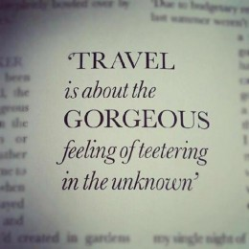
End of course!
Notes:
Background information for trainers

